Slide 1
Introduction to Rivanna
Ruoshi Sun
Senior Computational Scientist
Research Computing
University of Virginia

Slide 2



Rivanna
Rivanna is the university's primary resource for high-performance computation. It provides a platform for computationally-intensive research across disciplines.

Slide 3
Terminology
Node
Basic building block of a cluster
Usually a specialized computer
Two types of nodes:
Head Node – computer used for logging on and submitting jobs
Compute Node – computer that does most of the work
Core – an individual processor on a computer

Slide 4
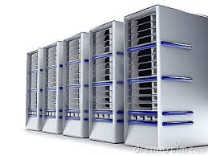
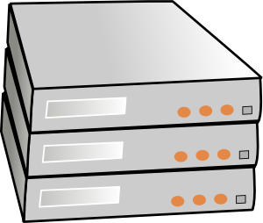
Rivanna Overview
Compute Nodes
Head Nodes
ssh client
Ethernet
Home Directory
Other Storage
Scratch
(GPFS)
Infiniband

Slide 5
Allocation (group)
Account (user)
Connection
Cluster Environment
Modules (software)
Partitions (hardware)
Slurm (scheduler)

Slide 6
Allocations

Slide 7
Allocations
Rivanna is allocated:
At the most basic level, an allocation refers to a chunk of CPU time that you can use to run your computations.
Only faculty, postdocs, and research staff may request an allocation.
Students must be sponsored by a faculty or research staff.
All individuals on a given allocation share the service units.
Allocations may be requested at https://www.rc.virginia.edu/userinfo/rivanna/allocations/
Allocations are measured in service units (SUs), where 1 SU = 1 core-hour

Slide 8



Getting an account on Rivanna
Request an Allocation
Receive Allocation and Account(s)
Research Computing
Allows access
Principle Investigator (PI)
Researchers/Students

Slide 9
Connecting & Logging Onto Rivanna

Slide 10
If You are Off-Grounds . . .
You may need to use the UVa VPN when connecting to Rivanna from an off-Grounds location.
To install the VPN on your computer, go to https://in.virginia.edu/vpn and follow the instructions.

Slide 11
How to connect to Rivanna
Open OnDemand, a graphical user interface through a web browser
examine and manipulate files and submit jobs.
access applications such as Desktop and Jupyterlab.
https://rivanna-portal.hpc.virginia.edu
2. SSH client, direct access to the command line

Slide 12
Connecting to Open OnDemand
To connect to Open OnDemand, open your web browser and type
https://rivanna-portal.hpc.virginia.edu
You will need to authenticate with Netbadge (i.e., “Netbadge” in).
After you log in, you will see the Dashboard.
You can connect to Open OnDemand from off-Grounds locations without a VPN connection.

Slide 13
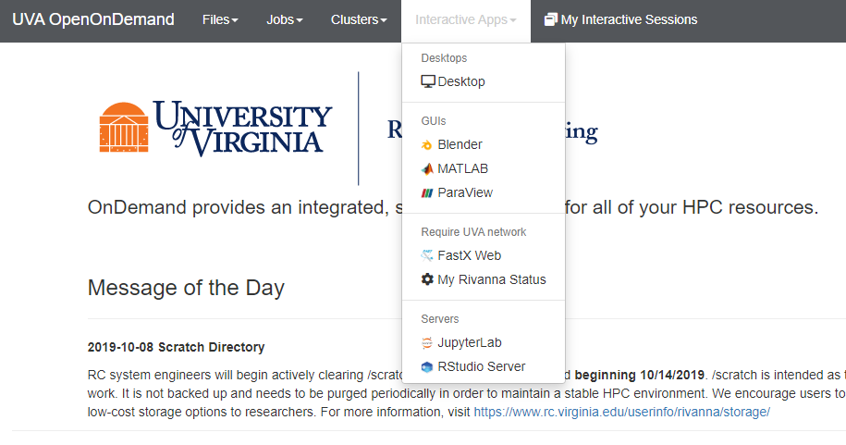
Interactive Apps

Slide 14
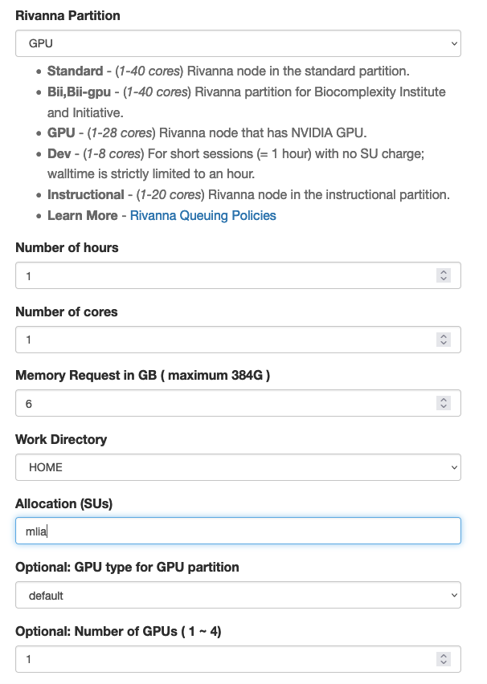
Specify computing resources that you need for your JupyterLab session.
After you fill in the form, it will re-populate with the same settings the next time that you connect to it.

Slide 15
Partition A subset of compute nodes with some common attribute
Select GPU

Slide 16
Number of hours Maximum time for your session
Number of cores Enter 1 for serial programs
Memory Request Default 6 GB per core

Slide 17
Work Directory Sets the default directory in JupyterLab and what you can access in the File Browser.
Allocation mlia

Slide 18
GPU type default: first available types: A100, V100, P100, K80, RTX 2080Ti
Number of GPUs 1

Slide 19
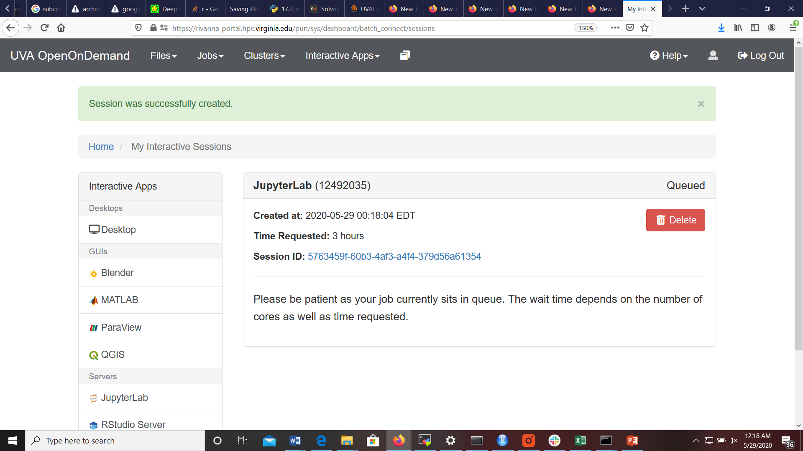
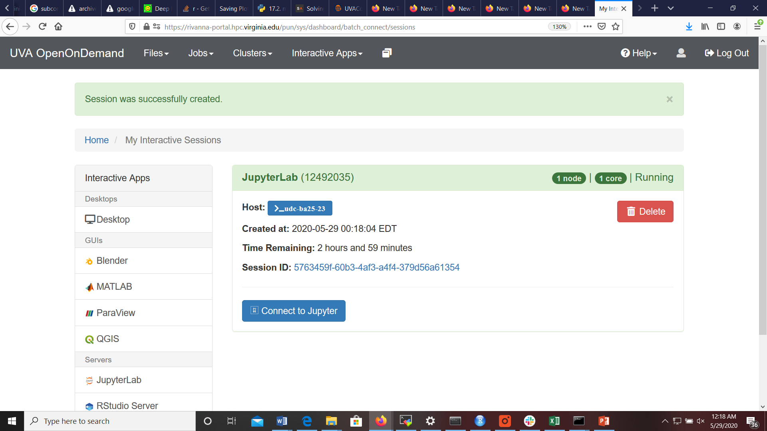
Waiting for the Session to Start
The screen will transition from a “Please be patient” statement to a “Connect to Jupyter” button.
Click on the “Connect to Jupyter” button.

Slide 20
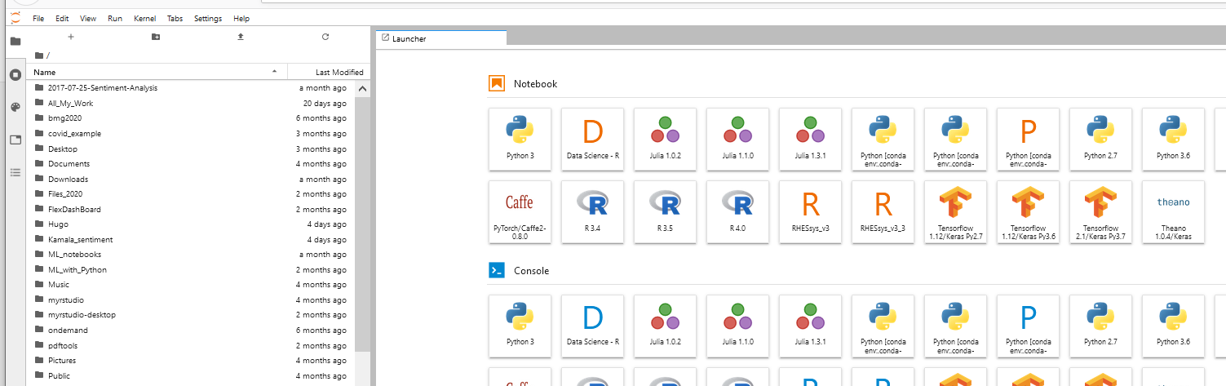
Demo
Start a JupyterLab session
[Left] Your home directory
[Right] Tiles (“kernels”) for underlying applications (e.g. TensorFlow)
Open a PyTorch/Tensorflow kernel and import it
[Just for today] Slurm Option: --reservation=mlia_training

Slide 21
Deleting Your Session
When you are done with your Jupyter Notebook, it is very important to delete the session.
Go back to the browser tab labeled “Interactive Sessions” and click on the red “Delete” button.

Slide 22
SSH Clients
Replace mst3k with your user ID.
Connecting to Rivanna
On a Mac or Linux system, simply open a Terminal application and type
ssh –Y mst3k@rivanna.hpc.virginia.edu
You may also want to install XQuartz on your Mac to use graphical tools on Rivanna.
On a Windows system, open the Command Prompt app and type
ssh –Y mst3k@rivanna.hpc.virginia.edu
You must use the UVa VPN when off-Grounds.

Slide 23
SSH Clients
SSH clients mostly use instructions typed at the command prompt.
You will need to become familiar with Linux/Unix commands.
See learning.rc.virginia.edu/tutorials/unix-tutorial/ to learn more
Some useful Unix/Linux commands:
$ ls
$ pwd
$ cd folder_name
$ cp file_1 file_2
$ rm file_1
$ cd ..

Slide 24
Hostnames for Rivanna
The hostname for the Interactive frontends: rivanna.hpc.virginia.edu
(does round-robin among the three front-ends)
However, you also can log onto a specific front-end:
rivanna1.hpc.virginia.edu
rivanna2.hpc.virginia.edu
rivanna3.hpc.virginia.edu

Slide 25
Cluster Environment

Slide 26
After you have logged in . . .
You will be in your home directory.
50 GB of storage capacity
For personal use; not shareable with other users
/scratch/$USER
10 TB of temporary storage
90-day purge policy
Limited to 350,000 files
For personal use; not shareable with other users

Slide 27
Checking your Storage
To see how much disk space you have used in your home and scratch directories, open a Terminal window and type hdquota at the command-line prompt:
$ hdquota
Type Location Name Size Used Avail Use%
================================================================================
home /home mst3k 50G 0 50G 0%
Project /project mlia 50G 1G 49G 2%
Scratch usage for mst3k
Block Limits | File Limits
Filesystem Fileset days GB quota limit in_doubt grace | files quota limit in_doubt grace Remarks
gpfs0 scratch 90 2 10240 12288 0 none | 5301 350000 420000 0 none

Slide 28
Checking your Allocation
To see how many SUs you have available for running jobs, type allocations at the command-line prompt:
$ allocations
Account Balance Reserved Available
----------------- --------- --------- ---------
mlia 50000 0 46189.7
for more information about a specific allocation, run:
'allocations -a <allocation name>'

Slide 29
Moving data onto Rivanna
You have several options for transferring data onto your home or /scratch directories.
Use the scp/rsync command in a terminal window.
Use a drag-and-drop option with MobaXterm (Windows) or Cyberduck (Mac OS).
For small files, use the Upload and Download buttons in the Open OnDemand Files App
Use the web browser in Desktop to download data from UVA Box.
Use the git clone command to copy git repositories
Set up a Globus endpoint on your laptop and use the Globus web interface to transfer files.
(See https://www.rc.virginia.edu/userinfo/globus/ for details)

Slide 30
How to edit a file on Rivanna
You can use:
The built-in editor in Open OnDemand. Just click on Files on the Dashboard, highlight the file that you want to edit and click on the edit button.
When in a Terminal Window, use vi/emacs/nano.
vi/emacs uses all keyboard shortcuts and may take a while to learn.
nano is a very basic editor. To launch, type: nano myfile.txt
In Desktop, you can use Pluma Text Editor (gedit).

Slide 31
Modules
Any application software that you want to use will need to be loaded with the module load command.
For example:
module load singularity pytorch/1.10.0
You will need to load the module any time that you create a new shell
Every time that you log out and back in
Every time that you run a batch job on a compute node

Slide 32
Module Details
module avail – Lists all available modules and versions.
module spider – Shows all available modules
module key keyword – Shows modules with the keyword in the description
module list – Lists modules loaded in your environment.
module load mymod – Loads the default module to set up the environment for some software.
module load mymod/N.M – Loads a specific version N.M of software mymod.
module load compiler mpi mymod – For compiler- and MPI- specific modules, loads the modules in the appropriate order and, optionally, the version.
module purge – Clears all modules.

Slide 33
Partitions
Rivanna has several partitions (or queues) for job submissions.
You will need to specify a partition when you submit a job.
Helpful commands:
qlist – list all partitions
qlimits – show limitations such as memory and cores

Slide 34

Need help?
Research Computing Zoom Office Hours
Tuesdays: 3 pm – 5 pm
Thursdays: 10 am – noon
To connect to the Zoom sessions, go to https://www.rc.virginia.edu/support/#office-hours and click on the “Join us via Zoom” button
Or, contact us through the forms at:
https://www.rc.virginia.edu/support/

